Slide 1
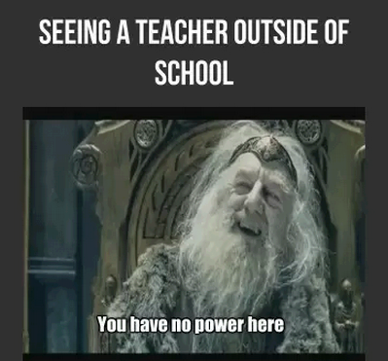
Chapter 13: Power, Politics, Conflict & Negotiations

Slide 2
Agenda
What is Power?
Forms of Power
  Think, Pair, Share: Favorite Boss
  Game of Thrones: 5 Forms of Power
Contingency Factors
Influence Tactics
  Game of Thrones: Influence Tactics
Responses to Influence
Minute Papers

Slide 3
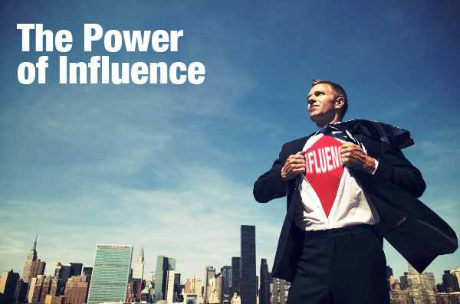
What is power?

Slide 4
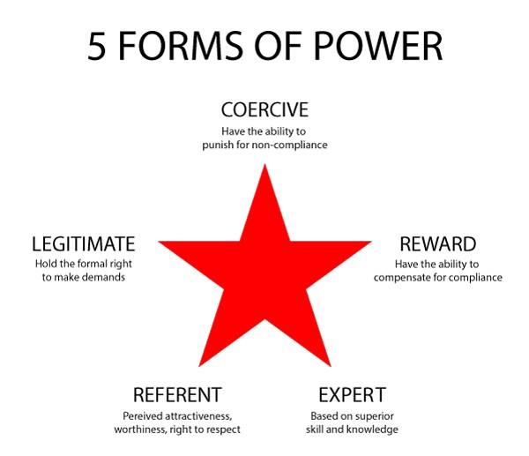
Power and Its Basic Forms

Slide 5
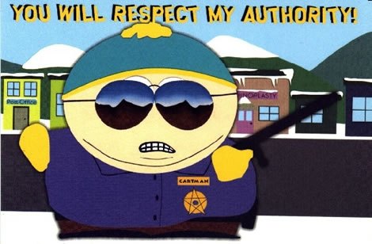
3 Types of Position Power
Legitimate Power: having formal authority or higher position

Slide 6
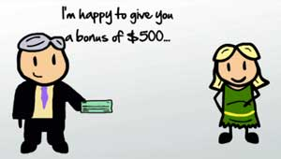
3 Types of Position Power
Reward Power: having control over resources or rewards

Slide 7
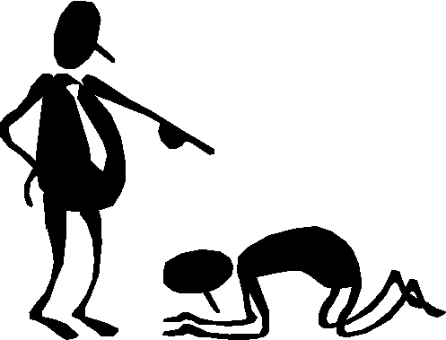
3 Types of Position Power
Coercive Power: having control over punishment

Slide 8
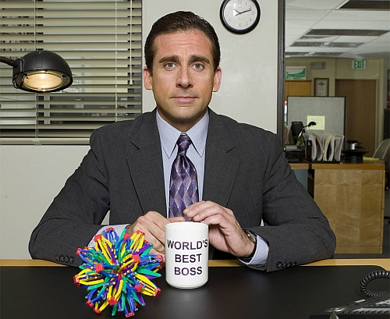
Think, Pair, Share
Think of a favorite boss, coach, teacher, or other person in authority
Identify what it was/is about that person that makes them your “favorite”
Discuss with your partner and try to find common themes

Slide 9
Power and Its Basic Forms
Organizational Power Includes:
Legitimate Power
Reward Power
Personal Power Includes:
Expert Power
Referent Power
Coercive Power
Power Associated with a Job or Position
Power Independent of Job or Position

Slide 10
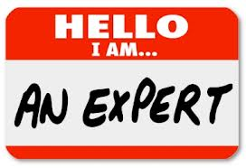
2 Types of Personal Power
Expert Power: derived from the person’s expertise, skills, or knowledge on which others depend

Slide 11

2 Types of Personal Power
Referent Power: when other’s desire to identity and be associated with a person

Slide 12

Game of Thrones: 5 Bases of Power
Notes:
https://www.youtube.com/watch?v=92DU70TQSOg

Slide 13
Contingency Factors
Certain situations in organizations that are likely to increase or decrease degree to which leaders can use their power to influence others
Most situations revolve around the idea that the more other employees depend on a person, the more powerful the person becomes

Slide 14
Contingency Factors
Degree that leaders can use power to influence others
Substitutability
Centrality
Discretion
Visibility

Slide 15
Using Influence
The use of an actual behavior that causes behavioral or attitudinal changes in others
Influence is not necessarily only exerted downward. You can exert power on:
Superiors
Peers
Subordinates

Slide 16
Influence Tactics
Highly Effective:
Rational persuasion
Inspirational appeal
Consultation
Collaboration
Moderately Effective:
Ingratiation
Personal appeals
Exchange
Apprising
Least Effective:
Pressure
Coalition

Slide 17
Game of Thrones: Influence Tactics
Notes:
https://www.youtube.com/watch?v=tA0eU6FRHDc

Slide 18
Nine general Influence Tactics
Rational persuasion. Using reason, logic, or facts.
Inspirational appeals Building enthusiasm by appealing to others’ emotions, ideals, or values.
Consultation. Getting others to participate in planning, making decisions, and changes.
Ingratiation. Getting someone in a good mood prior to making a request; being friendly, helpful, and using praise or flattery.
Personal appeals. Referring to friendship and loyalty when making a request.
Exchange. Making express or implied promises and trading favors.
Coalition tactics. Getting others to support your effort to persuade someone.
Pressure. Demanding compliance or using intimidation or threats.
Legitimating tactics. Basing request on authority or right, organizational rules or polices, or express or implied support from superiors.

Slide 19
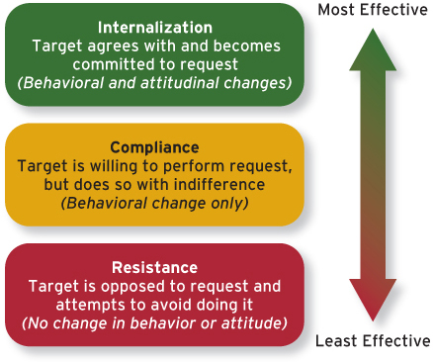
Responses to Influence Attempts

Slide 20
Minute Paper
Any questions or clarifications that you have about the topics covered in class that day.
Comments or opinions that you would like to express about the topics covered in class that day.
A statement explaining what you learned in class that day and a way in which you might apply this new knowledge personally.

